Slide 1
Survey Data Analysis Tool
Kongari Abhinav – 2420030263
Aluru Sri Tejaswi Priyank – 2420030276
Sai Vinesh – 2420030691
Guide - DR.N.SUNANDA

Slide 2
Problem Statement
Survey data is collected from many people to understand their opinions, interests, and preferences. Analyzing raw survey data can be difficult because the data may contain missing values, duplicate entries, and inconsistent responses. It is also difficult to understand large amounts of survey data without proper analysis and visualization.
The main problem is that users may need technical knowledge and different tools to clean, analyze, visualize, and interpret survey data. there is a need for a simple tool that can process survey data and present the results in an easy-to-understand way.
The “Survey Data Analysis Tool” is developed to solve this problem by cleaning the survey data, performing basic data analysis, creating visualizations, and displaying the results through an interactive dashboard.

Slide 3
Real-world relevance
Survey data is widely used in real life by businesses, educational institutions, healthcare organizations, and researchers to understand people's opinions, preferences, and feedback. Analyzing a large amount of survey data manually can be difficult and time-consuming.
The “Survey Data Analysis Tool” helps users clean, analyze, and visualize survey data in a simple and understandable way. Businesses can use it to understand customer preferences, colleges can use it to analyze student feedback, and organizations can use it to study employee opinions. The tool can also be useful in healthcare and research surveys for identifying patterns and trends in collected data.

Slide 4
Motivation for selecting the problem
Survey data is collected in many areas such as education, business, healthcare, and research. Raw survey data can be difficult to understand and analyze, especially when the dataset contains a large number of responses, missing values, or inconsistent data.
The main motivation for selecting this problem was to understand how data science techniques can be used to solve a real-world problem. This project provides an opportunity to apply concepts such as data cleaning, data analysis, data visualization, and statistical testing in a practical application.
The goal is to develop a simple and useful tool that can convert raw survey data into meaningful insights and help users understand the results easily. The project was also selected because it has applications in many real-world areas and can be extended to analyze different types of survey datasets.

Slide 5
Objectives
Specific and measurable objectives :- To develop a tool for uploading and analyzing structured survey datasets.
To clean the survey data by handling missing values, duplicate records, and inconsistent data.
To perform basic exploratory data analysis and generate summary statistics.
To create visualizations such as bar charts, pie charts, and histograms to understand survey responses easily.
To apply the Chi-Square test to identify relationships between selected survey variables.
To integrate the analysis results and visualizations into a simple interactive dashboard.

Slide 6
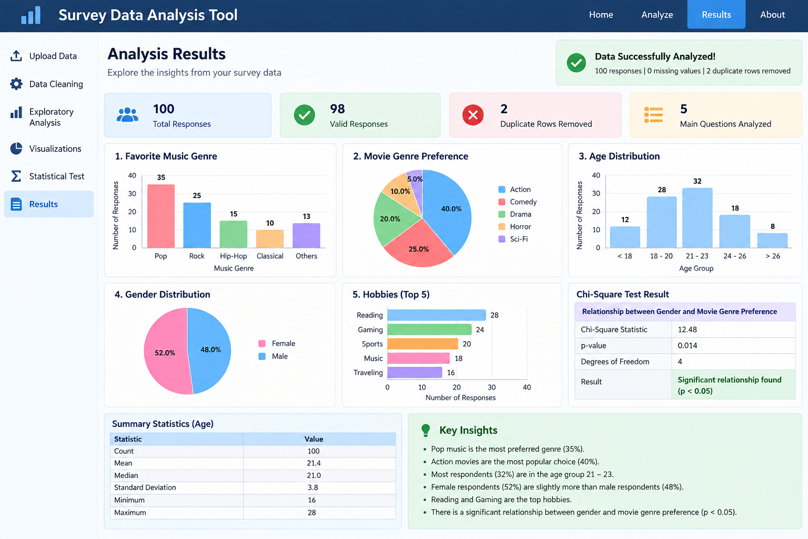
Expected Outcomes
A cleaned and processed survey dataset that is ready for analysis.
Easy-to-understand summary statistics showing important patterns in the survey data.
Visual representations of survey responses using different charts and graphs.
Statistical results showing whether there is a significant relationship between selected variables.
A simple interactive dashboard where users can view and explore the analysis results.
A reusable tool that can be applied to different structured survey datasets in areas such as education, business, healthcare, and research.

Slide 7
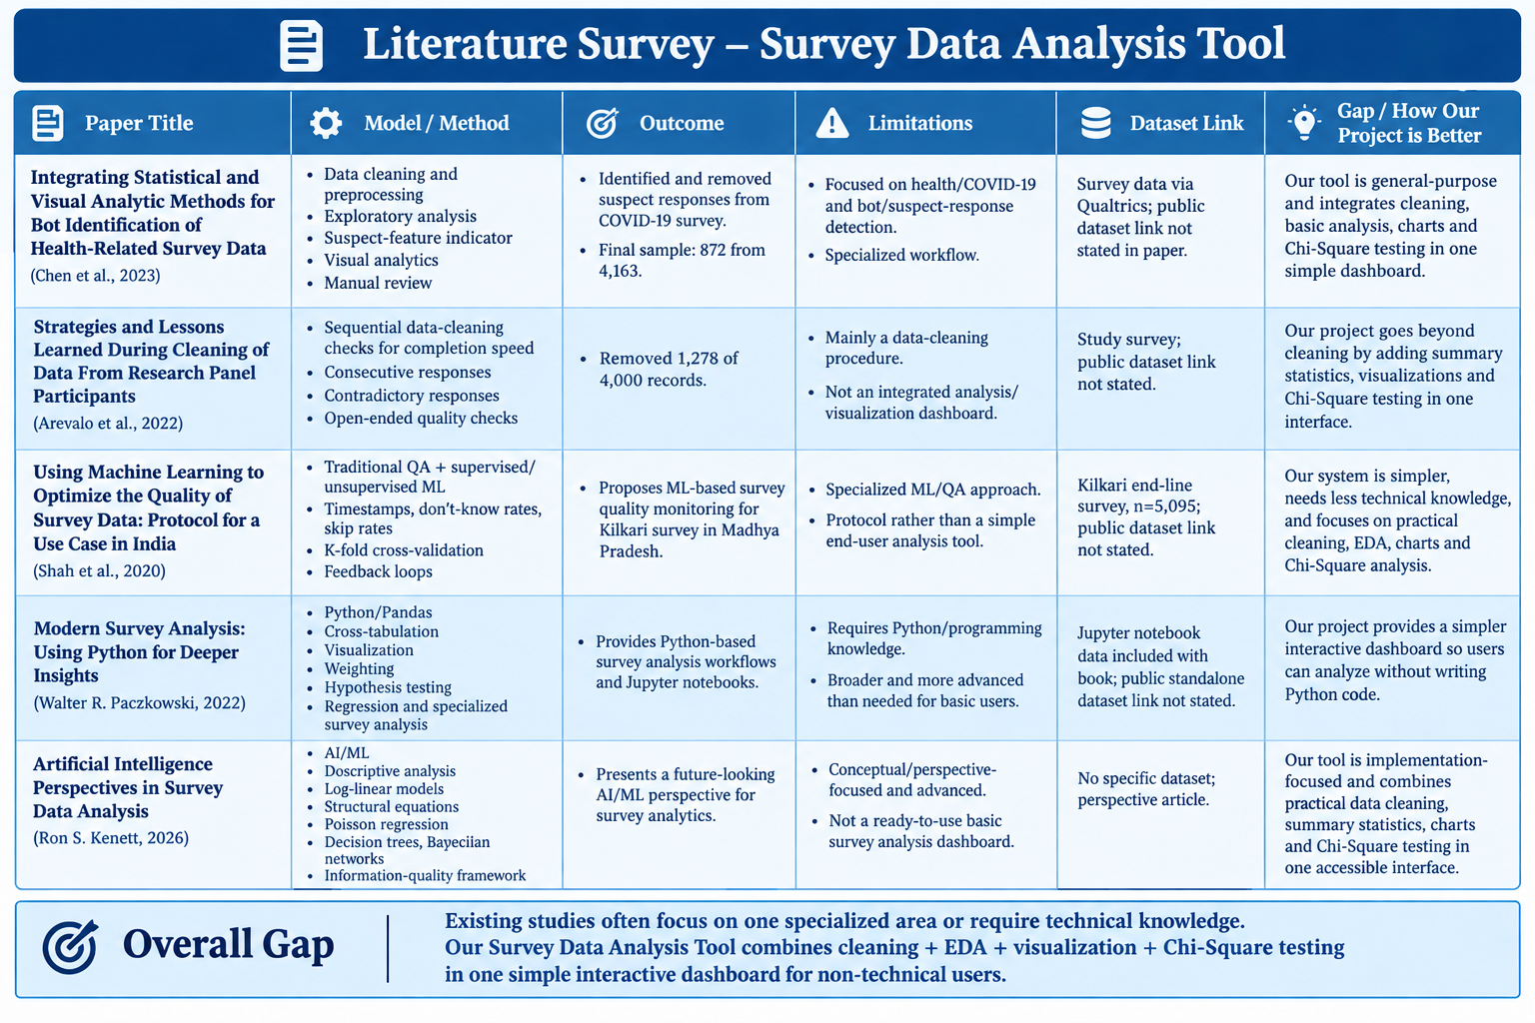
Literature survey/existing system

Slide 8
Limitations / Gaps
Raw survey data may require manual cleaning before analysis.
Different tools may be required for data cleaning, analysis, visualization, and statistical testing.
Tools such as Python and R require programming knowledge.
Large survey datasets can be difficult for non-technical users to understand.
Analysis results may not be available in a single simple interface.

Slide 9
How the Proposed Project addresses the gap
The proposed Survey Data Analysis Tool provides a simple and structured approach for analyzing survey data. It combines data cleaning, exploratory data analysis, visualization, and statistical testing in a single system.
The tool helps users handle missing values, duplicate records, and inconsistent data. It also generates summary statistics and visualizations such as bar charts, pie charts, and histograms. The Chi-Square test can be used to analyze relationships between selected survey variables.

Slide 10


